Slide 1


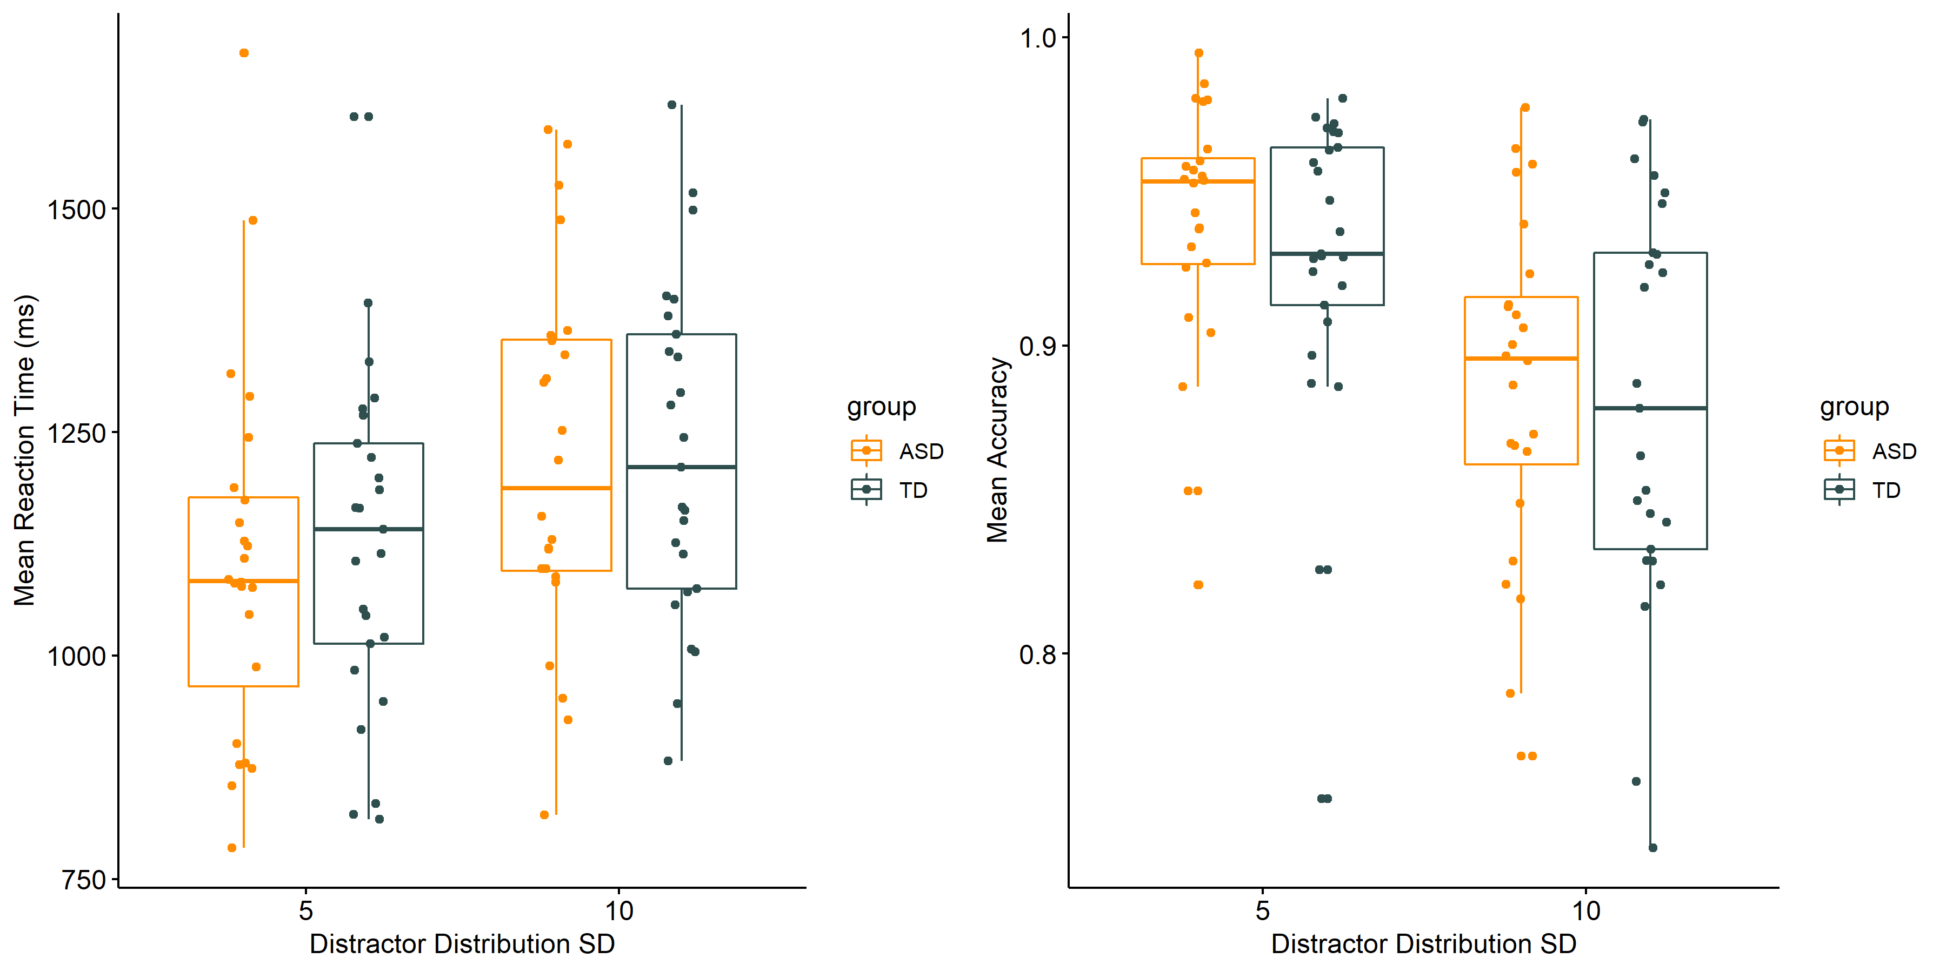
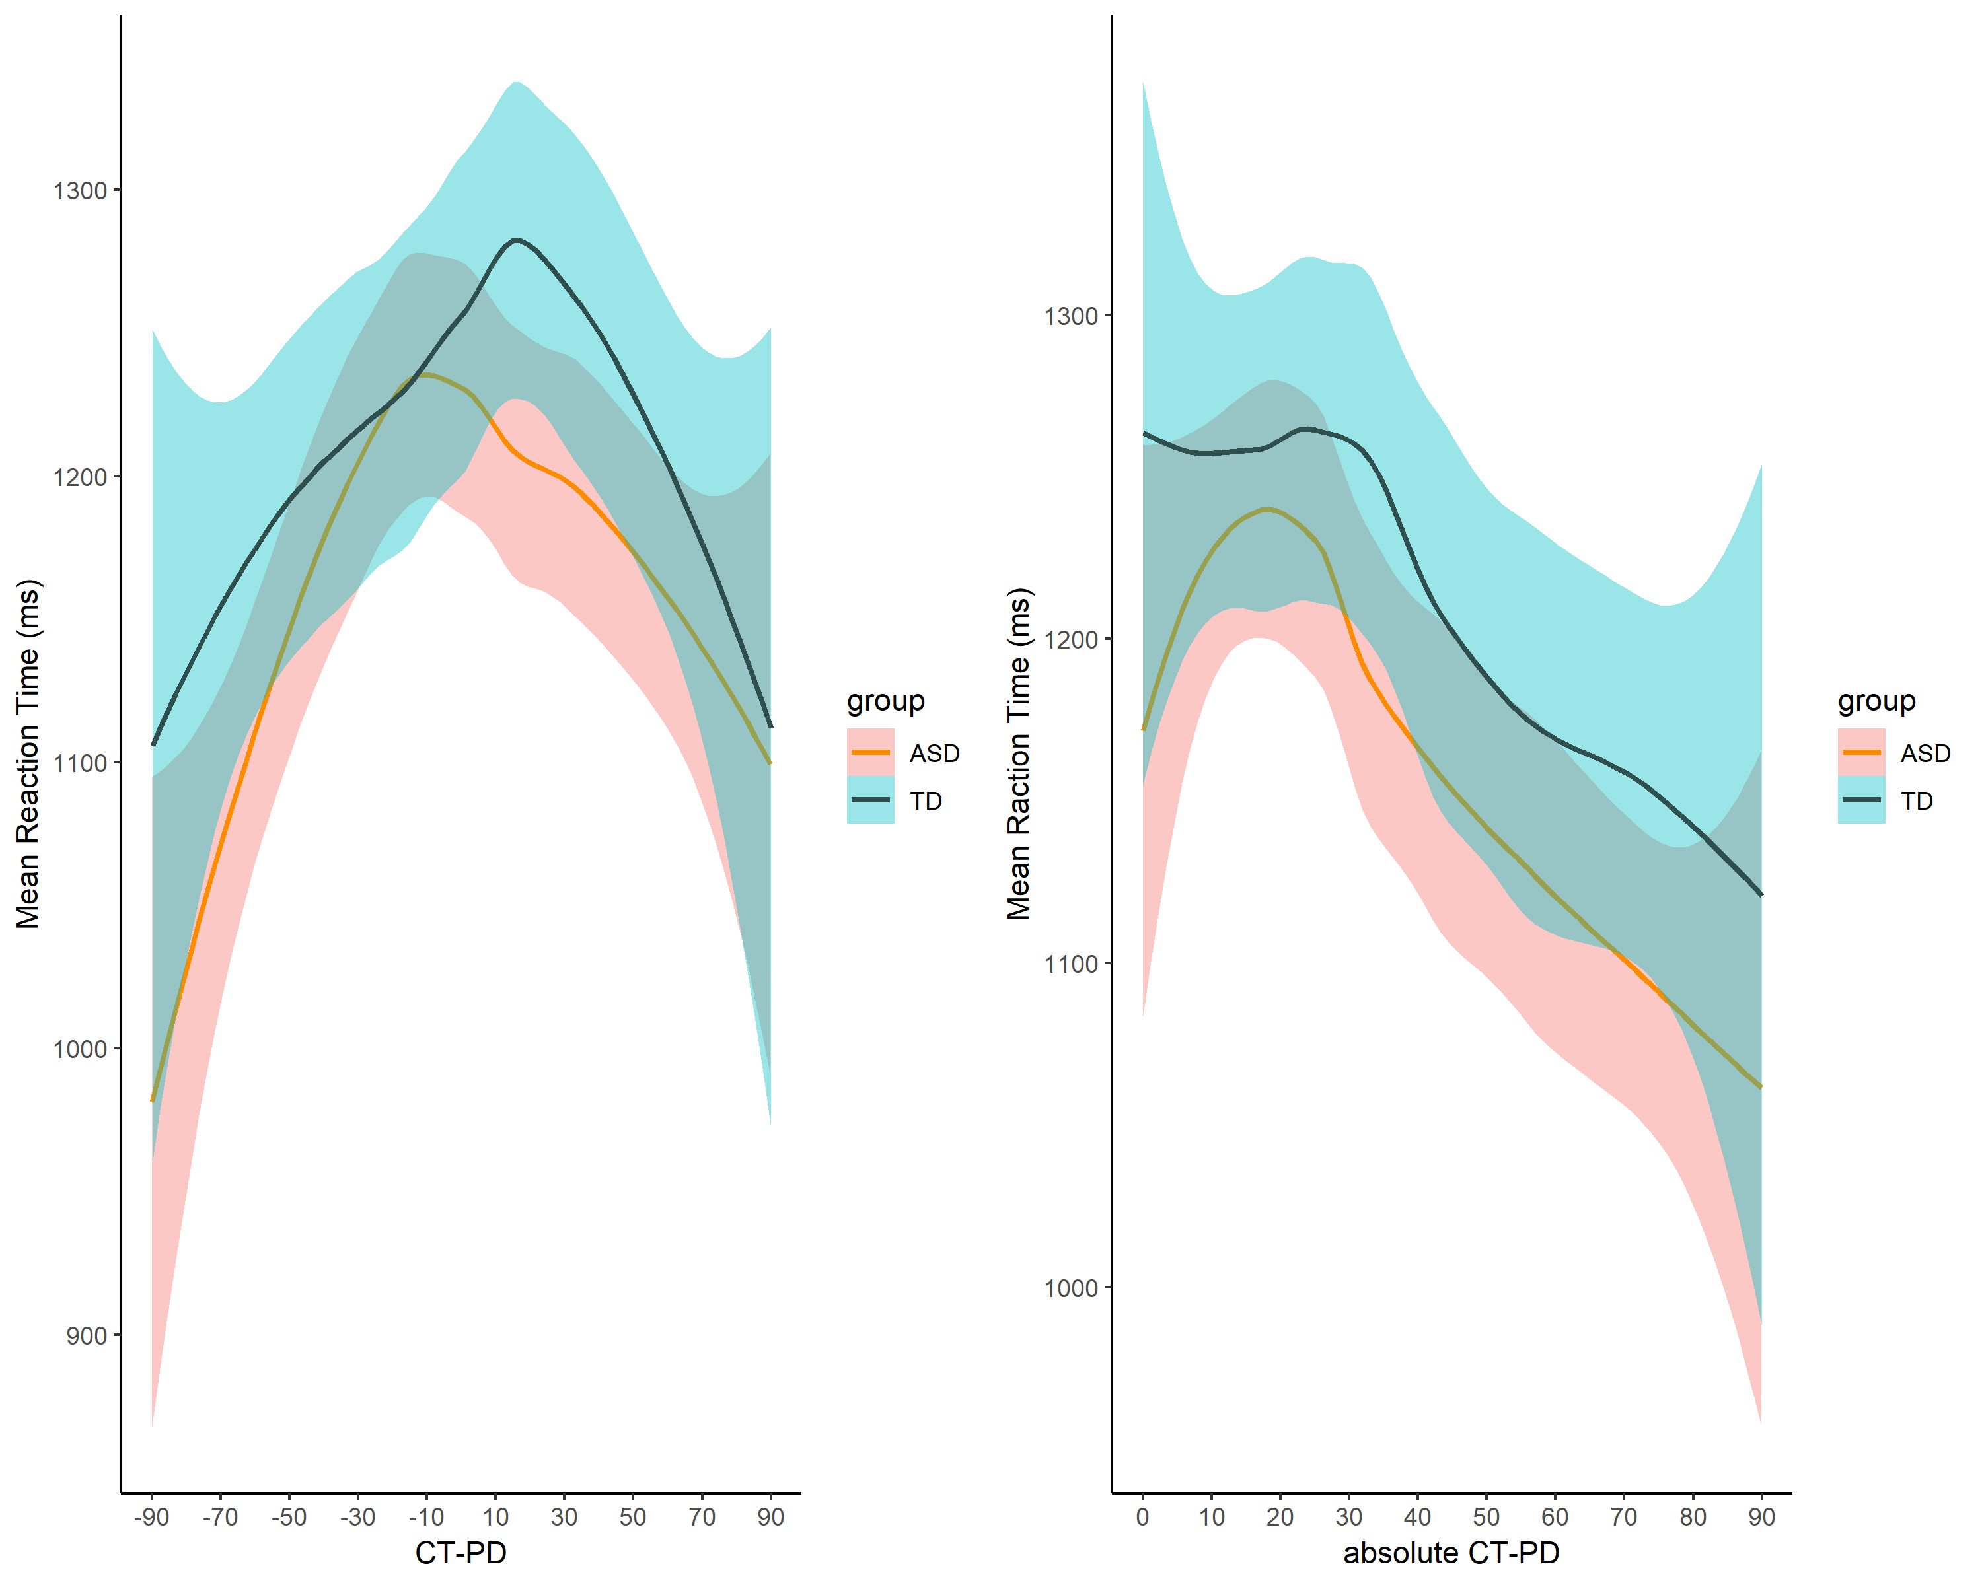
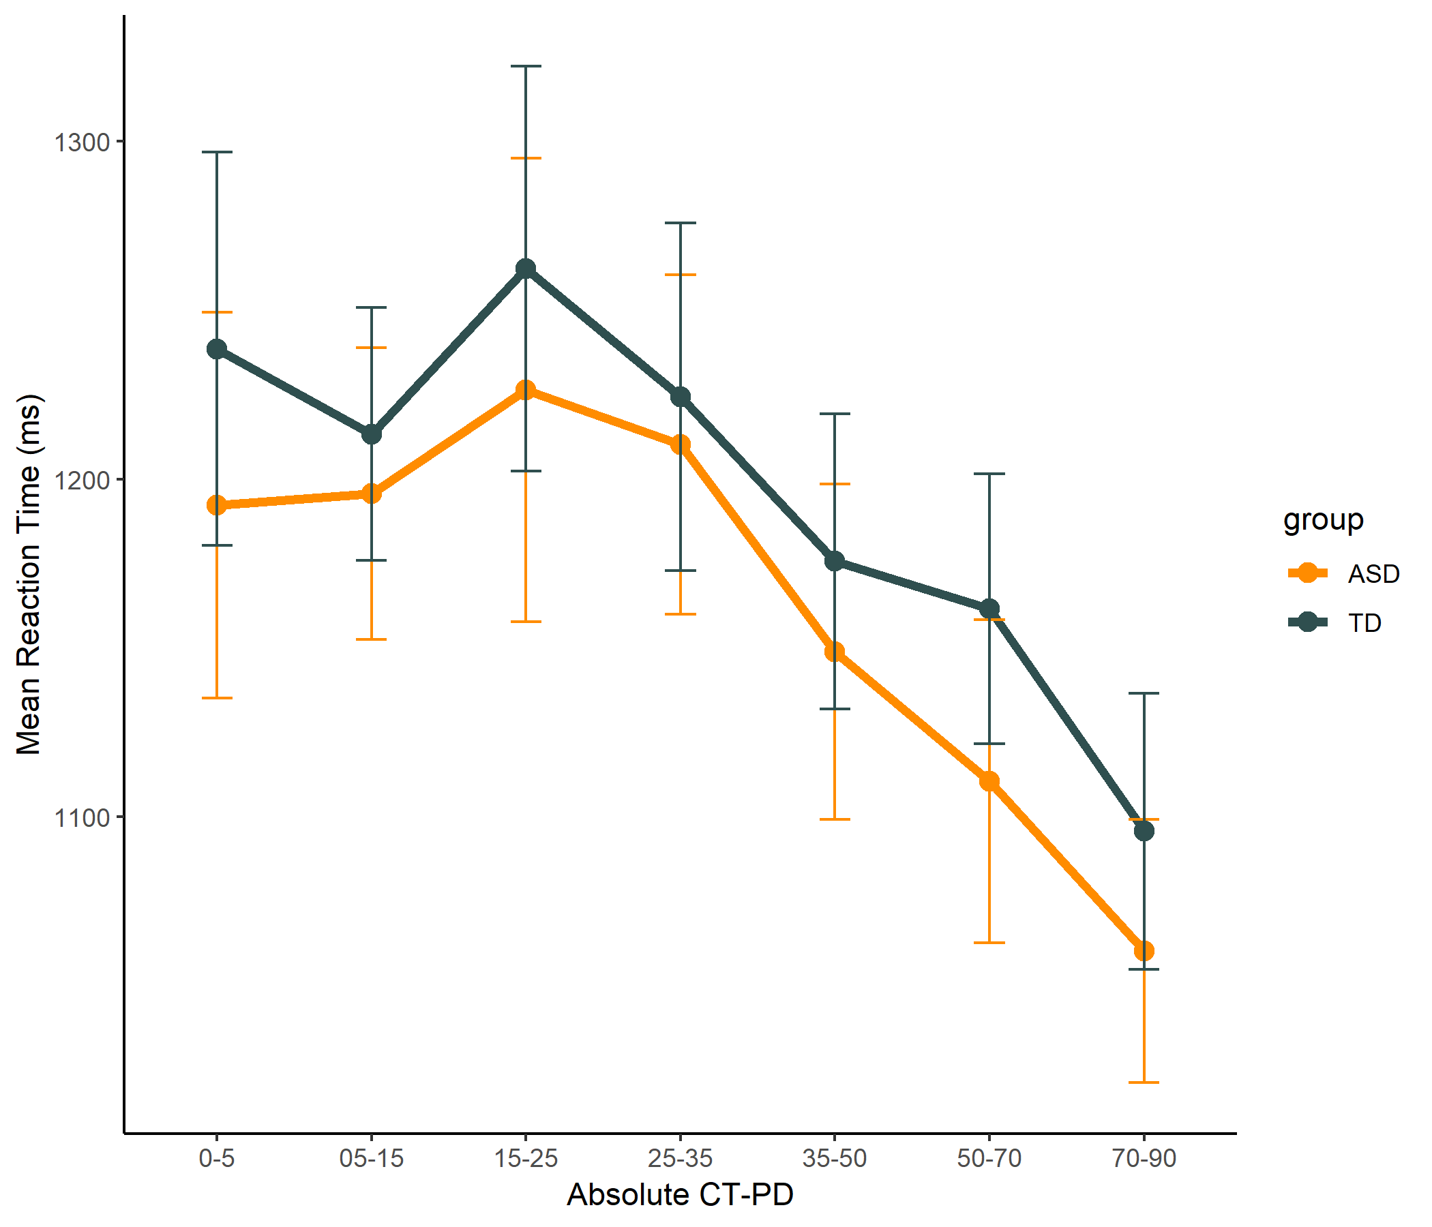
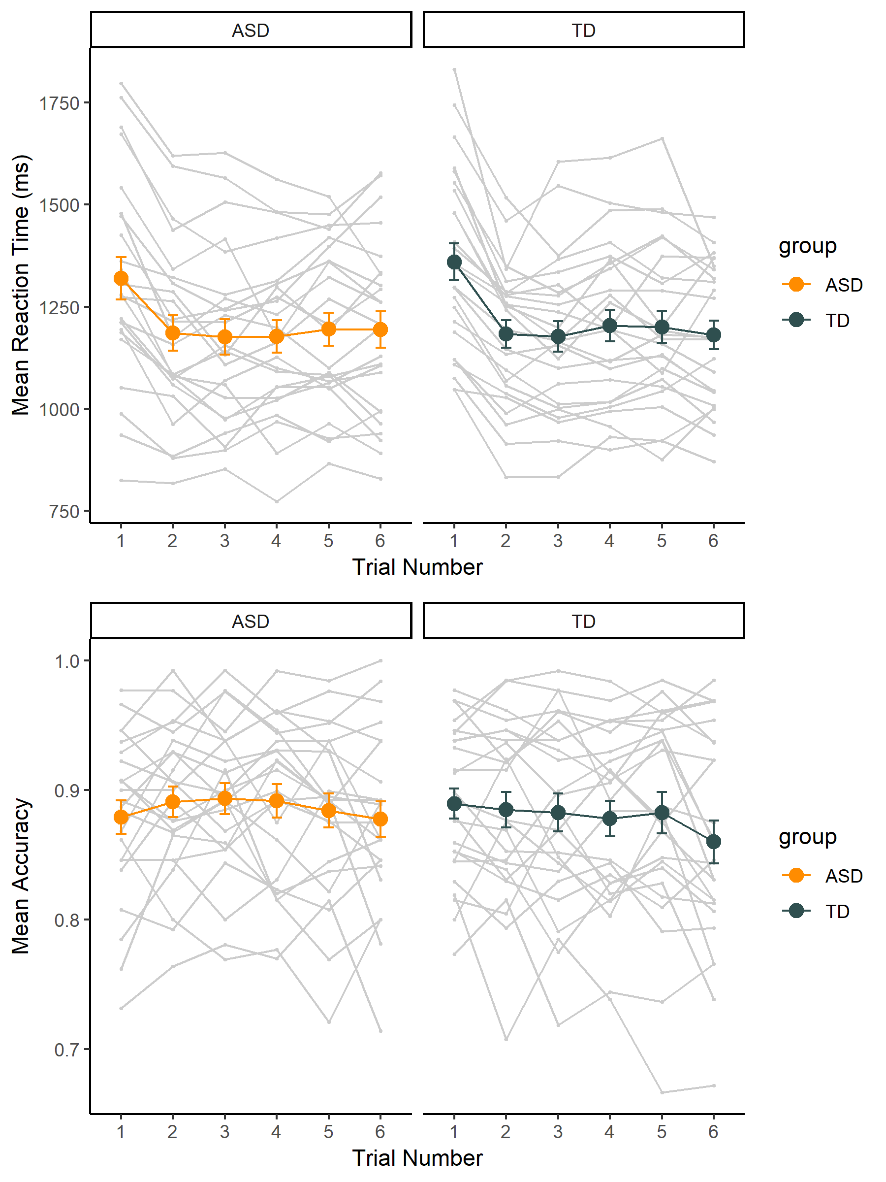
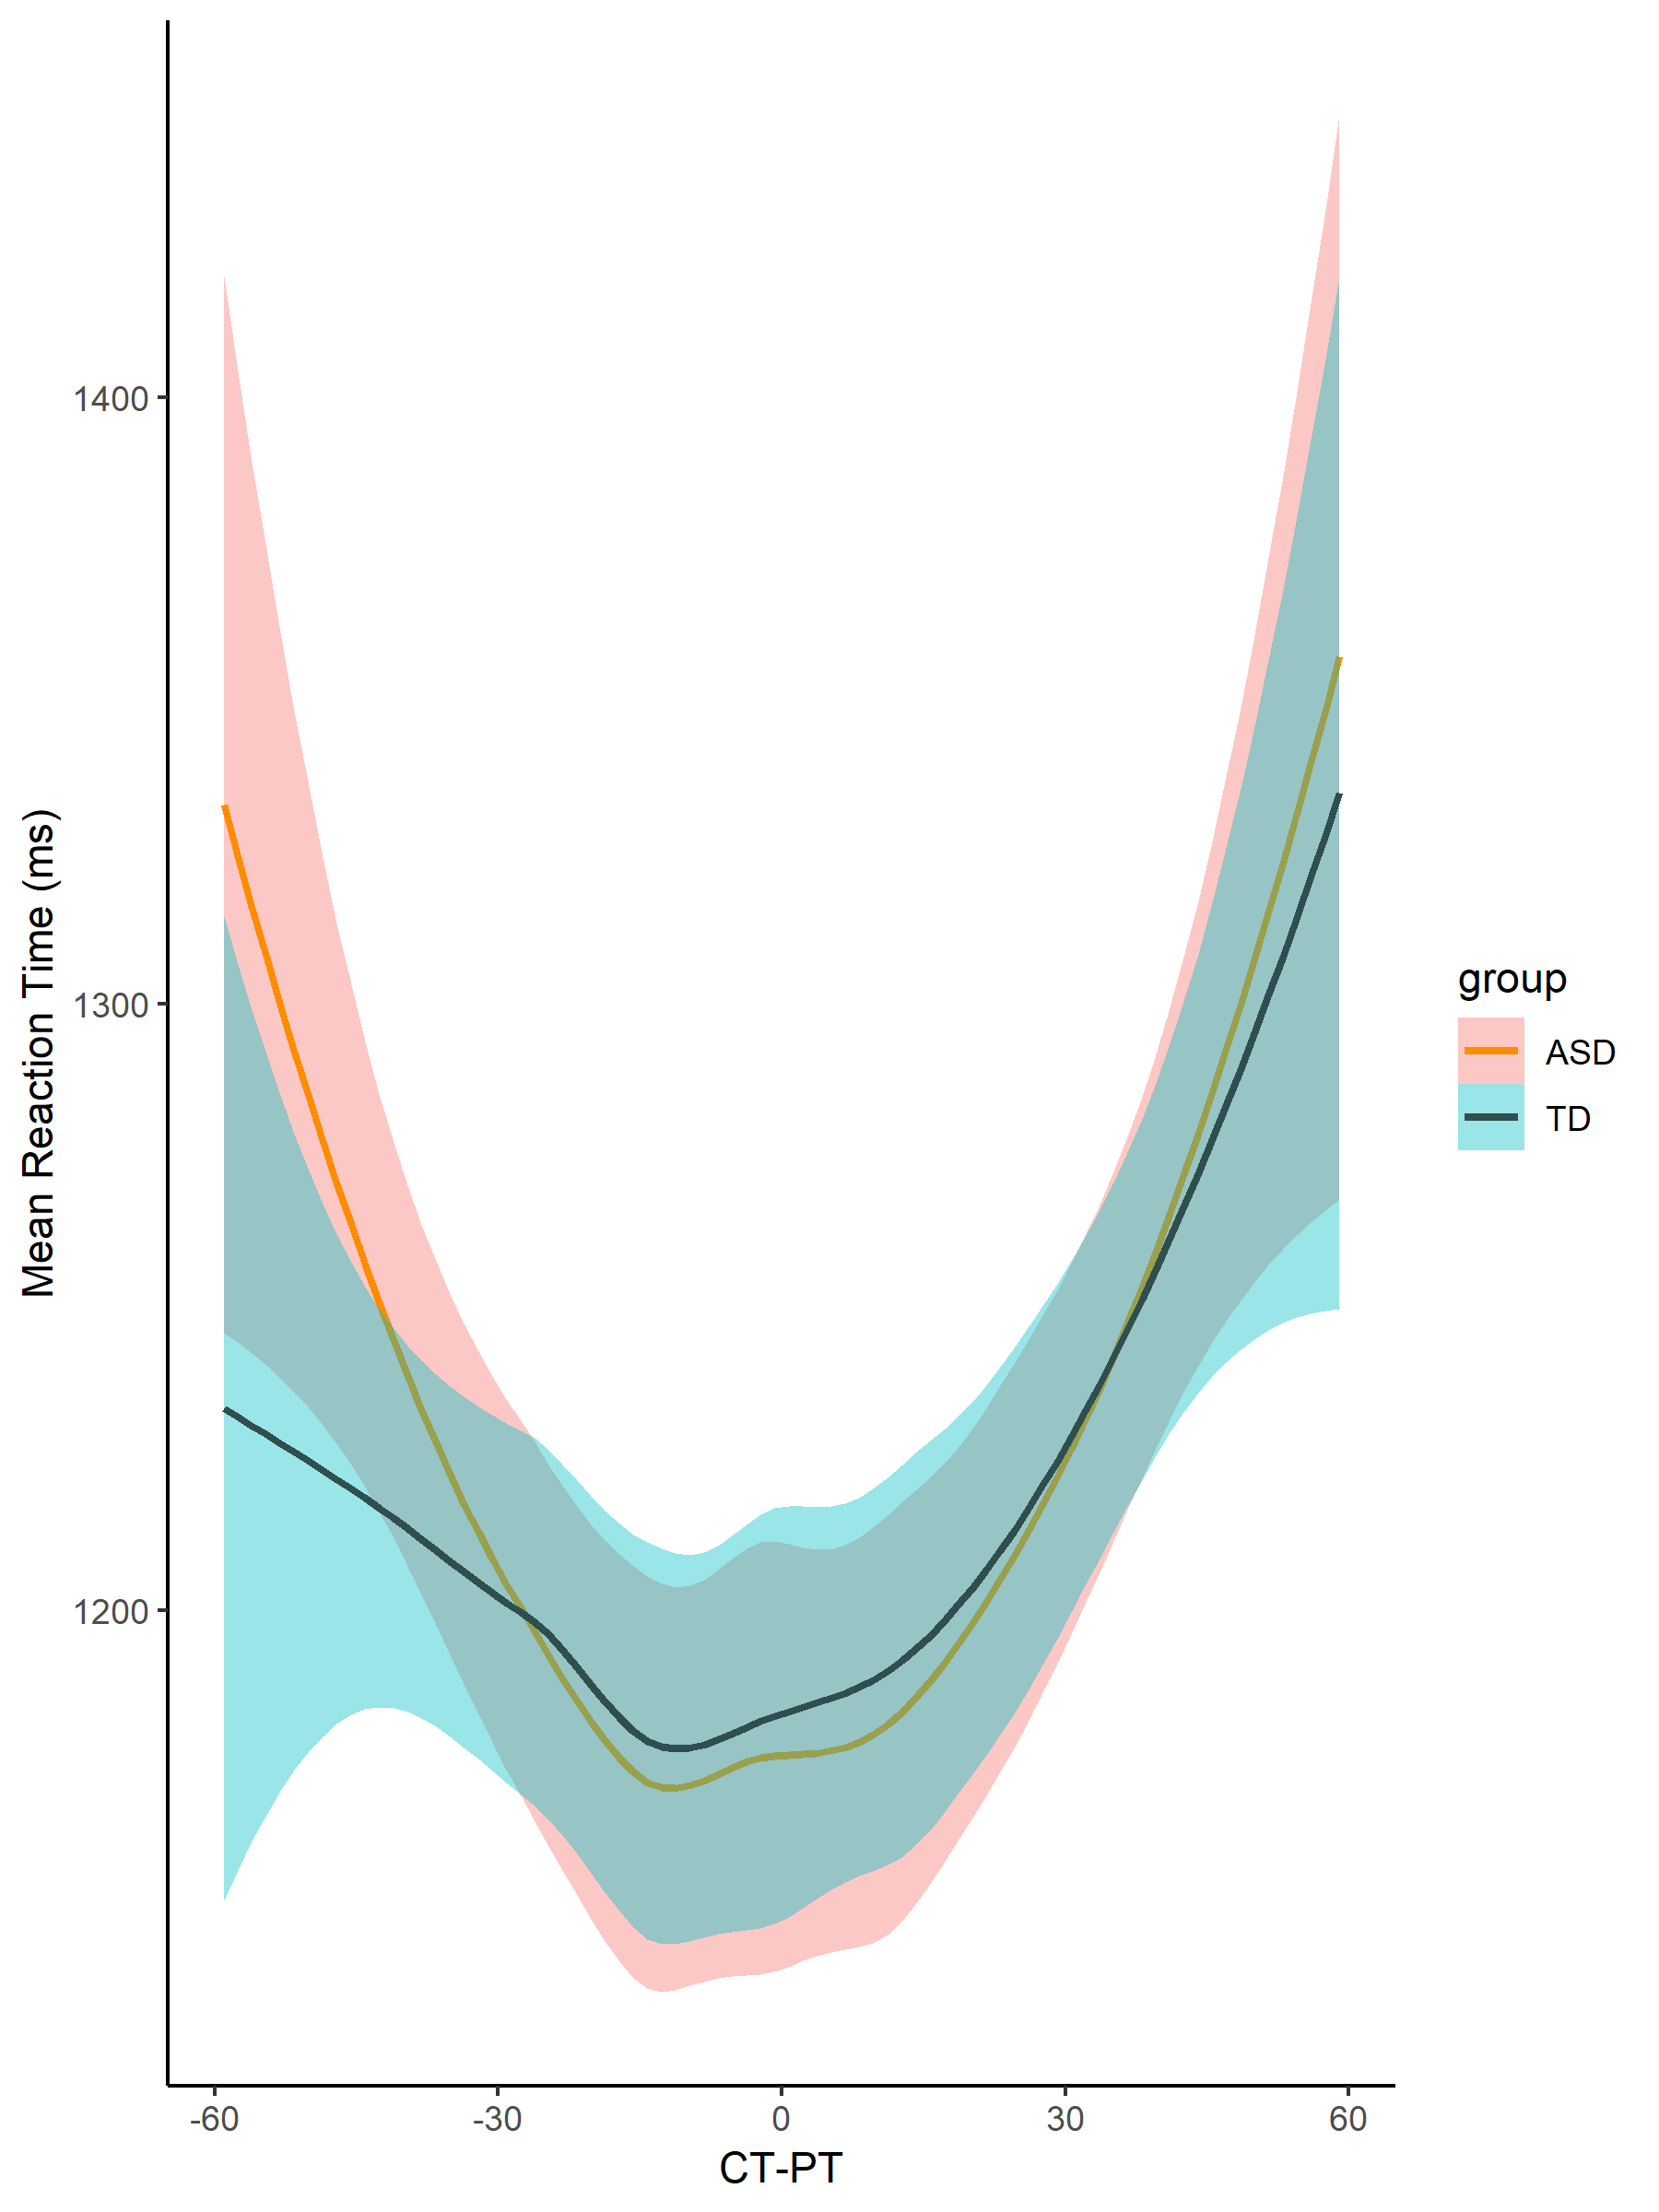
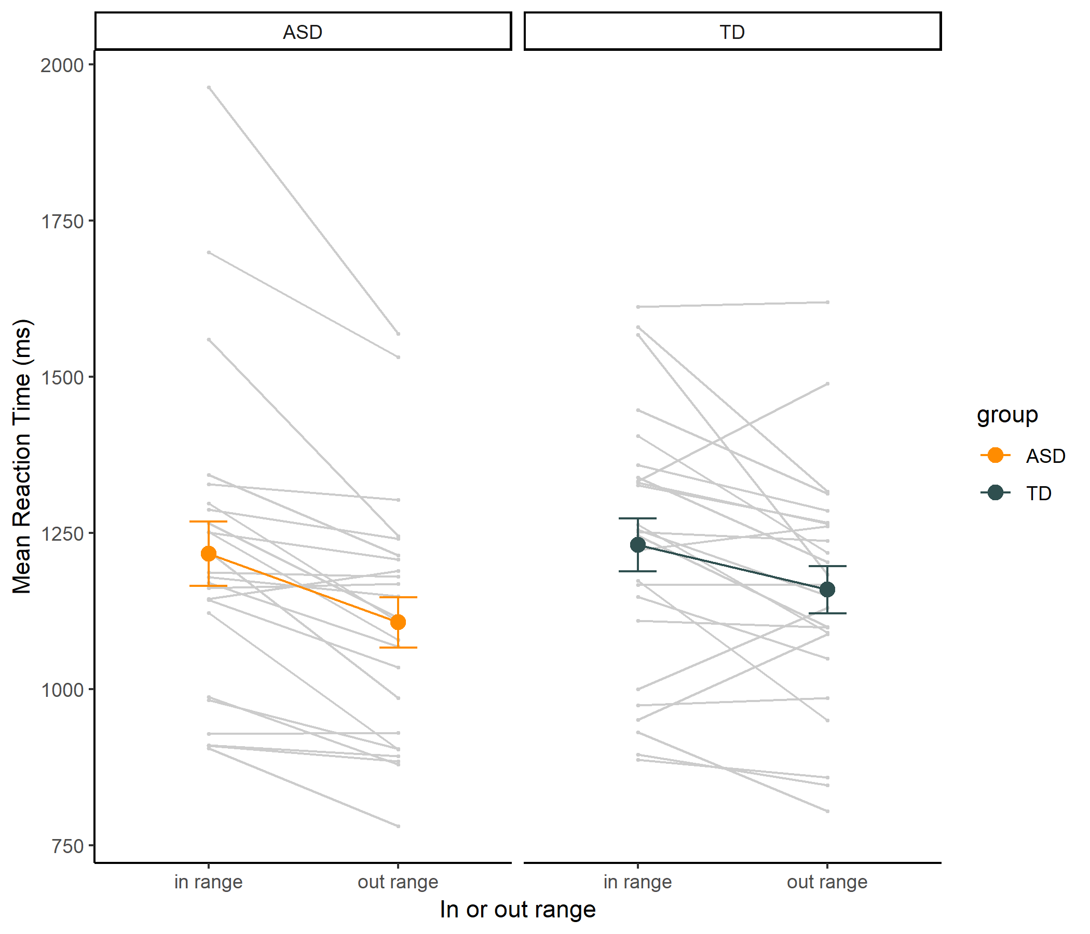
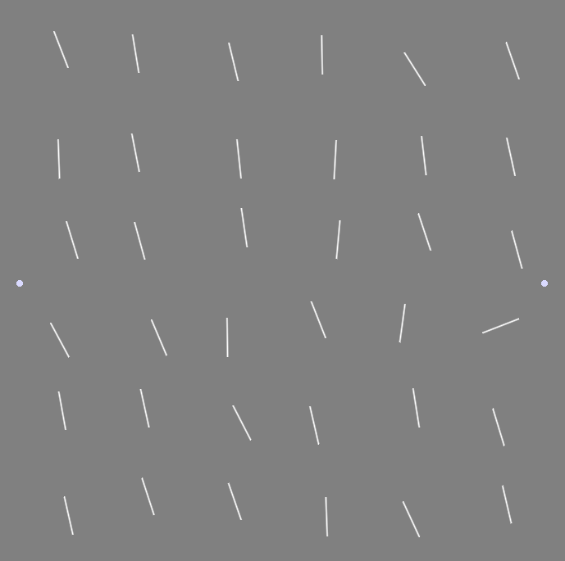
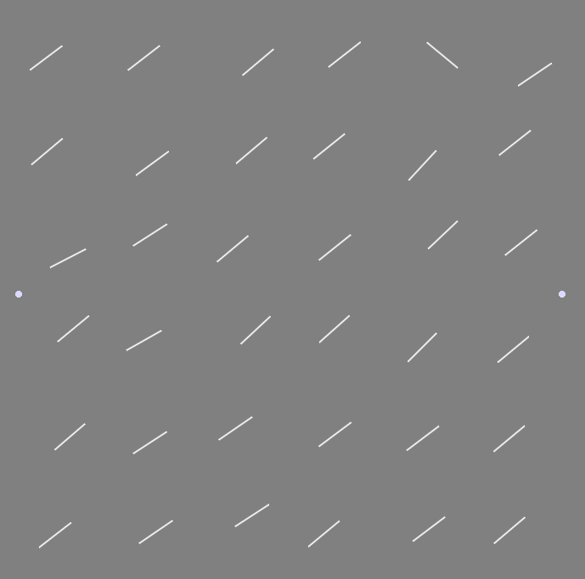
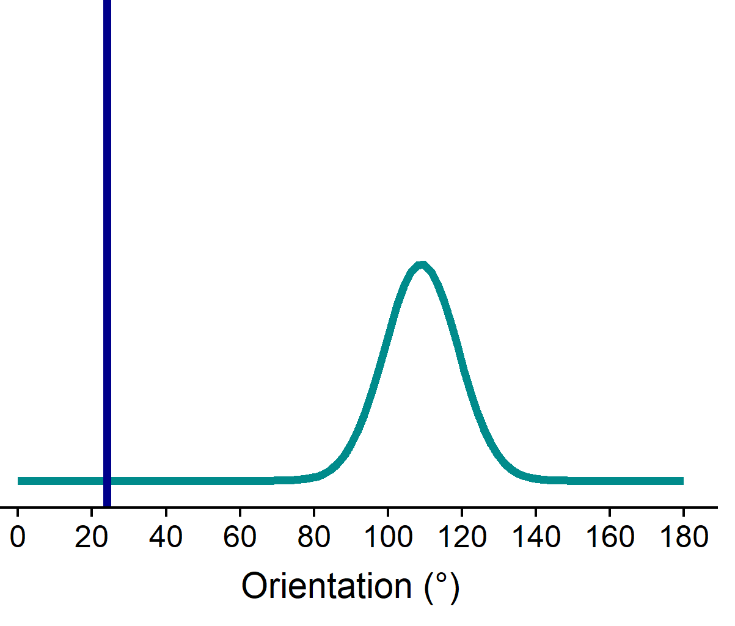
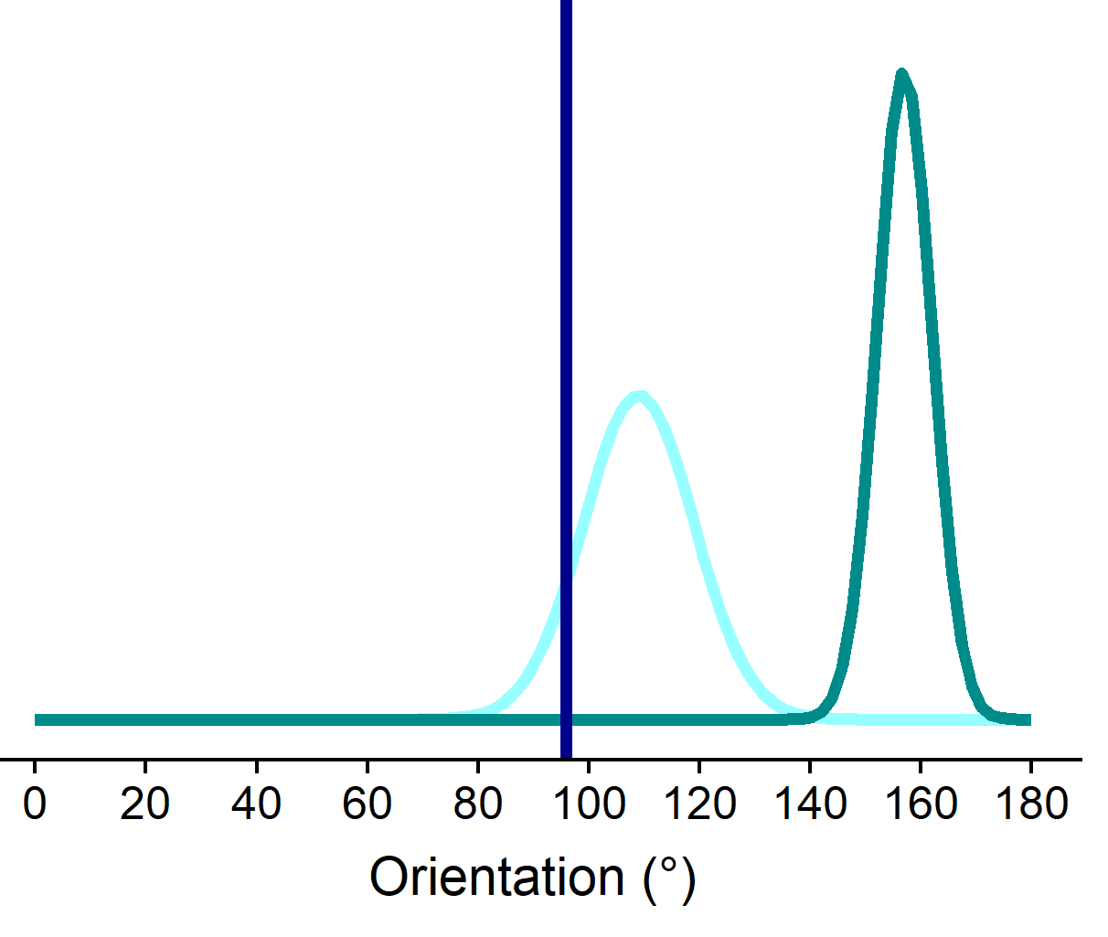




Implicit learning of perceptual distributions in children with autism spectrum disorder
Lisa Lemmens^{1,2}, Sander Van de Cruys^{1,2}, Andrey Chetverikov³, Laurie-Anne Sapey-Triomphe^{1,2}, Ilse Noens^{2,4}, Johan Wagemans^{1,2} (1) Laboratory of Experimental Psychology, KU Leuven, Belgium; (2) Leuven Autism Research (LAuRes), KU Leuven, Belgium; (3) Donders Institute for Brain, Cognition, and Behaviour, Radboud University, Nijmegen, Netherlands; (4) Parenting and Special Education Research Unit, University of Leuven, Leuven, Belgium
Introduction
Results
Recent theories of autism spectrum disorder (ASD) based on the Predictive Coding framework hypothesize differences in implicit learning based on the statistical regularities of the environment in individuals with ASD.
Previous studies revealed evidence for the ability of children with ASD to represent sets of low-level stimuli by its mean (i.e. ensemble perception) when assessed explicitly.
Chetverikov and colleagues (2016) found evidence for implicit learning of feature distributions’ parameters (mean, variance and shape) in adults assessed by repetition and role-reversal effects in an odd-one-out visual search task.
Overall performance per condition for each group
Role-reversal effects in test streaks: RTs over CT-PD
**
**
Linear mixed model with absolute CT-PD, group and group x absolute CT-PD as predictors of RT:
Significant negative slope for absolute CT-PD (B = -.05 (.01), t = -5.47, p < .0001).
No significant effect of group or interaction effect.
Objective
To test whether children with and without ASD are able to implicitly extract and exploit the statistical properties (mean, variance, shape) of the distributions of sets of differently oriented lines to improve their visual search performance.
** p < .0001
Repetition effect in prime streaks
Priming by target in prime streaks
**
RTs on test trials with an absolute CT-PD of 35°-50°, 50°-70° and 70°-90° significantly lower compared to average RTs on all smaller CT-PD bins in both groups.
No significant effect of group or interaction effect.
**
Methods
**
**
**
**
Participants
24 children with an official ASD diagnosis (10 – 14y)
25 typically developing (TD) children (10 – 14y)
➔ Group-wise matched for age, gender ratio and intelligence
Stimuli and Procedure
Odd-one-out visual search task
Array of 36 differently oriented lines
“Upwards arrow key” when target is in upper part
“Downwards arrow key” when target is in lower part
Orientation of distractor lines sampled from Gaussian distribution
Target orientation 60° to 120° different from distractor distribution mean
RTs on test trials with CT-PD outside the range of the previous distractor distribution significantly lower compared to RTs on test trials with CT-PD inside the range.
No significant effect of group or interaction effect.
**
**
***
***
** p < .0001
** p < .0001
** p < .0001
Prime trial, DSD = 10°
Test trial, DSD = 5°
Prime streaks
5 – 6 prime trials
Within each streak:
Distractors sampled from same distribution
Target orientation & location randomly changes
Test streaks
1 – 2 test trials
Difference between Current Target orientation and Previous Distribution mean (CT-PD) ranges from -90° to +90°
Discussion
References
No difference in overall performance between children with and without ASD, in line with predictions based on High and Inflexible Precision of Prediction Errors in individuals with ASD (HIPPEA; Van de Cruys et al., 2014).
Both groups implicitly extract the statistical properties of the distractor distributions to improve their search performance to the same extent.
Search times on test trials linearly decrease when CT-PD increases, without a significant breakpoint in both groups. Children with and without ASD seem to represent the distributions in a less precise way compared to adults.
Chetverikov, A., Campana, G., & Kristjánsson, Á. (2016). Building ensemble representations: How the shape of preceding distractor distributions affects visual search. Cognition, 153, 196–210. https://doi.org/10.1016/j.cognition.2016.04.018
Van de Cruys, S., Evers, K., Van der Hallen, R., Van Eylen, L., Boets, B., de-Wit, L., & Wagemans, J. (2014). Precise minds in uncertain worlds: Predictive coding in autism. Psychological Review, 121(4), 649–675. https://doi.org/10.1037/a0037665
Distractor distribution
Distractor distribution
www.gestaltrevision.be
Target
Previous distractor distribution
Target
Contact: lisa.Lemmens@kuleuven.be
www.gestaltrevision.be
VSS 2019

